Slide 1
Overview and Special Features of SAGE
System for the Analysis of Global Energy markets
Pia Hartman & Barry Kapilow-Cohen
Office of Integrated Analysis and Forecasting
Energy Information Administration
Prepared for the NEMS Conference
March 12, 2002

Slide 2
Overview of International Energy Modeling Activity at EIA
Existing Forecasting Tool
  World Energy Projection System (WEPS)
    Integrated set of pc-based spreadsheets
    Incorporates projections from independently documented models, and assumptions regarding future energy intensity (E/GDP) trends & the rate of incremental energy requirements met by each fuel type over time
    Used to develop forecasts for the International Energy Outlook (IEO):
        Total energy consumption, by fuel (oil, natural gas, coal, nuclear, renewables)
        Net electricity consumption
        Energy consumption for transportation sector, by fuel
        Energy-related carbon dioxide emissions, by fuel

Slide 3
Overview of International Energy Modeling Activity at EIA (cont’d)
New Forecasting Tool in Development
  System for the Analysis of Global Energy Markets (SAGE)
    15-region, pc-based, linear programming model of world energy markets
    Developed using MARKAL modeling framework
    User-friendly input structure & output reporting capability
    Projection horizon up to 50 years, in 5-year steps
    Inter-region trade in energy and/or emissions
    Two operational modes: dynamic LP or time-stepped
    Intended use: 1) develop set of IEO forecasts, 2) tool for policy/scenario analysis involving international energy markets
Notes:
MARKAL - large international infrastructure knowledge base
Captures int’l trading in energy and/or emissions – flexible multilateral relationships built in
Dynamic LP – assumes perfect foresight - answers “What’s best”
Time stepped - Sequential Period Solving - approximates market simulation
150,000 rows - quickly solved -- less than 20 minutes

Slide 4

15 SAGE Country/Region Models
  USA
  Canada
  Mexico
  Central & South America
  Western Europe
  Eastern Europe
  Former Soviet Union
  China
  India
  Other Developing Asia
  South Korea
  Japan
  Africa
  Middle East
  Australia & New Zealand

Slide 5
Each SAGE Regional Model…
      Depicts a Reference Energy System (RES) for that region
      Employs common naming conventions & units
      Draws from comparable energy and economic/demographic data to develop the energy service demand estimates
        Energy Statistics and Balances (International Energy Agency)
        International Energy Annual (Energy Information Administration)
        World Economic Outlook, World Industry Monitor (DRI/WEFA)
        World Populations, Global Report on Human Settlements (United Nations)
Comprehensive Inputs & Assumptions Templates

Slide 6
RES Building Blocks
Resource Technologies
1. Energy Carriers
e.g. crude oil
liquefied petroleum gas
gasoline
distillate
jet fuel
2. Technologies
e.g. extraction
import
refining
electricity generation
light duty vehicles
airplanes
cookstoves
3. End-Use Energy Service Demands
categorized by sector
Process Technologies
Conversion Technologies
Demand Technologies
Multiple End-Use
Energy Service Demands

Slide 7
End-Use Energy Services Represented in SAGE
Residential Sector (11) Commercial Sector (8) Transportation Sector (13)
Space Heating Space Heating Personal Automobiles
Space Cooling Space Cooling Personal Light Duty Trucks
Refrigeration Refrigeration Buses
Water Heating Water Heating Commercial Heavy Trucks
Cooking Cooking Commercial Medium Trucks
Lighting Lighting Commercial Light Trucks
Clothes Washing Electric Office Equipment Two & Three Wheeled Vehicles
Clothes Drying Other Commercial Energy Services Domestic Aviation
Dishwashing International Aviation
Residential Electric Appliances Passenger Rail
Other Residential Energy Services Industrial Sector (6) Freight Rail
Iron & Steel Internal Navigation
Non-Ferrous Metals International Water Shipping
Chemicals
Non-Metallic Minerals Agriculture Sector (1)
Pulp & Paper Total Agriculture Energy Demand
Other Industries
.

Slide 8
Technology Representation in SAGE
Each technology is described by a set of parameters, including:
  Technical Parameters
  Efficiency Energy Carrier Input & Output Mix
  Capacity Factor Availability Factor
  Physical Lifetime Bound on activity levels or capacity
  Economic Parameters
  Investment Costs Discount Rate
Fixed O&M Costs Bound on Investment
  Variable O&M Costs
  Environmental Parameters
  Emissions factors Bound on Emissions

Slide 9
SAGE Solutions
Demand-driven
Objective function minimizes discounted energy system costs
Identify least-cost combinations of technologies and fuels for each 5-year solution period, employing either fixed energy service demands, or price-elastic energy service demands*
Various modes of operation:
      Single Region, or Multiple Region* runs
      Energy & Emissions Trading*
      Dynamic LP (perfect foresight), or Time-Stepped Approach* (imperfect expectations)
*See last slide for status of these features
Notes:
Time-stepped Version Allows
Technology learning for many technologies (as opposed to dynamic LP) (implementation is underway)
Modeling structure to avoid “all-or-nothing” or “knife-edge” solutions (implementation is underway)
Much less costly integration of economic feedback (to be done)

Slide 10
Learning-By-Doing
Returns to Adoption
Background
Learning-by-doing--well documented since 1930’s
Wright (1936) -- direct labor costs of manufacturing an airframe fell by 20% with every doubling of cumulative output
Subsequent authors broadened analysis of learning to other costs and showed costs declined with experience
Application in SAGE
Costs decline as the market accumulates operational and manufacturing experience
Cumulative capacity built is a surrogate for “market experience”
Credit for international builds
Notes:
“Learning by doing” is the process by which the market gains operational and manufacturing experience. Cumulative capacity is surrogate for experience.
This feature can illustrate the “market lock-out” phenomenon.

Slide 11
Learning Curves – Electricity Sector
Three piece-wise non-linear curves for overnight costs, one for each learning interval
Overnight Cost (C) is a function of Cumulative Capacity (Q)
C(Q) = a * Q ^{-b}
Progress Ratio (pr) defines the speed of learning: f = % cost decline with doubling of cumulative capacity
pr = 2^{- b} = ( 1- f)
b = - ln(1-f)/ln(2); a = C(Q₀)/Q₀^{-b}
Notes:
In the NEMS formulation, we are not convinced that the progress ratio remains unchanged as a function of cumulative production.
We divide technological phases and progress into three groups, revolutionary, evolutionary, and mature each with its own progress ratio (learning factor) -- current estimated shown in a later slide.

Slide 12
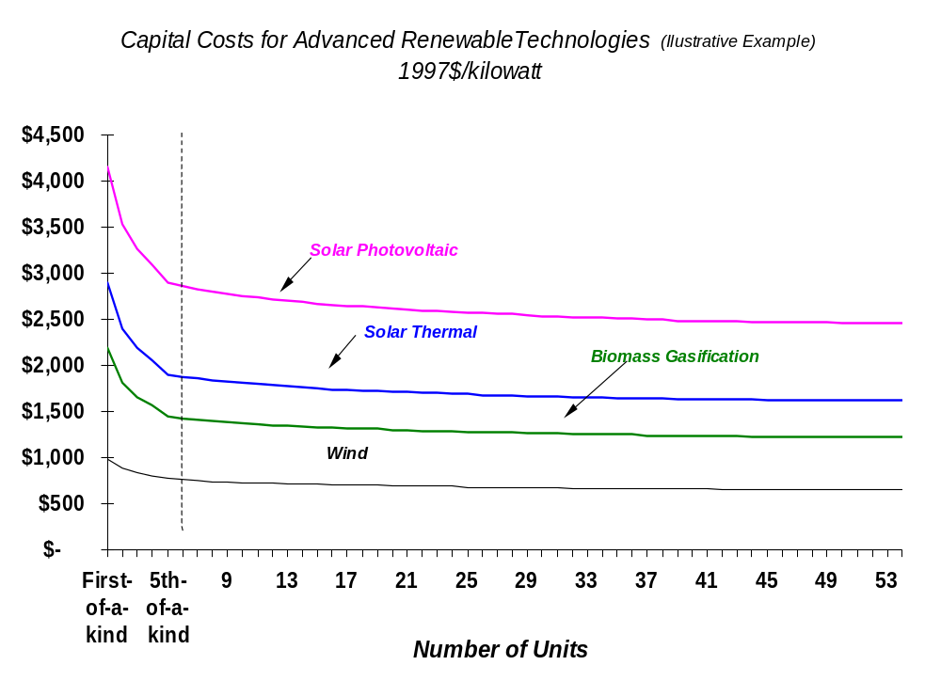

Slide 13
Market Adjustment/Penetration Algorithm
Select “noise” (“close-enough”) parameter
Select the fraction of each market segment that should be reallocated to marginally uncompetitive technologies
Solve SAGE for the “reduced costs”
Use “reduced costs” and “noise” parameter to determine “close” technologies within each market group
Recalculate market shares for technologies that were “close enough” based on their relative economics in their markets
Notes:
The “Noise” Parameter is User selectable. It is intended to correct for uncertainties, regional labor and material cost variations or other aggregation biases. The actual value is yet to be determined but we feel something between 10 – 20 % of the incremental market is appropriate.
We set tiny lower bounds for all technologies that we want to consider in the market adjustment algorithm, usually all commercially available technologies.
The recalculation of market shares for technologies ends up setting new lower bounds for those that were close enough to earn a market share. The rest of the lower bounds are reset to zero. Only a small portion of the capacity is reallocated.
The market share formula currently being investigated is
Share of technology I = P ^{–a} / [Sum over all technologies in the group that were close enough of (P_{k} ^{–a})

Slide 14
Status of SAGE Development
Proof of Concept has been completed and tested for 15 regions
User interface software for front-end (inputs & assumptions) and back-end (results & analysis) has been developed
Internal review and adjustment of inputs and assumptions is underway (transportation sector for all regions is close to final for all 15 regions; other sectors are being enhanced simultaneously) – expected completion by this fall
Initial market share algorithm for the time-stepped version has been implemented and will be extensively tested over next few months
Energy and emissions trading to be implemented and tested over the next few months
Learning Curve structure to be implemented and tested by this fall
Anticipate using SAGE for IEO2003 and policy analysis thereafter
Notes:
Proof of concept stage - with place holder data (IEO2002 has been replicated)

